Slide 1
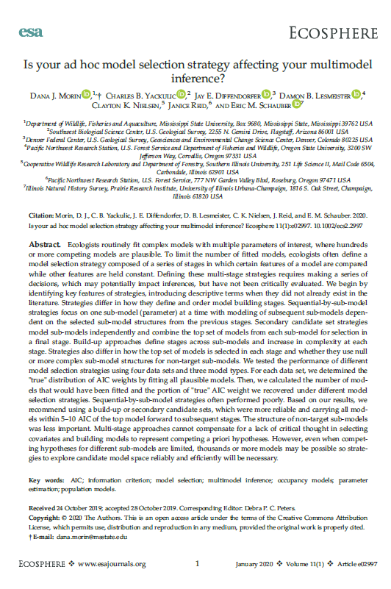
Model selection and model averaging (in R)
Pretty controversial topics, particularly for Bayesian analysis
Focus here is on hypothesis development combined w/ maximum-likelihood & information-theoretic criteria like AIC
Lots of opinions on this, so feel free interrupt and express yours!

Slide 2
(My idea of an ideal) model fitting and model selection (exercise)

Slide 3
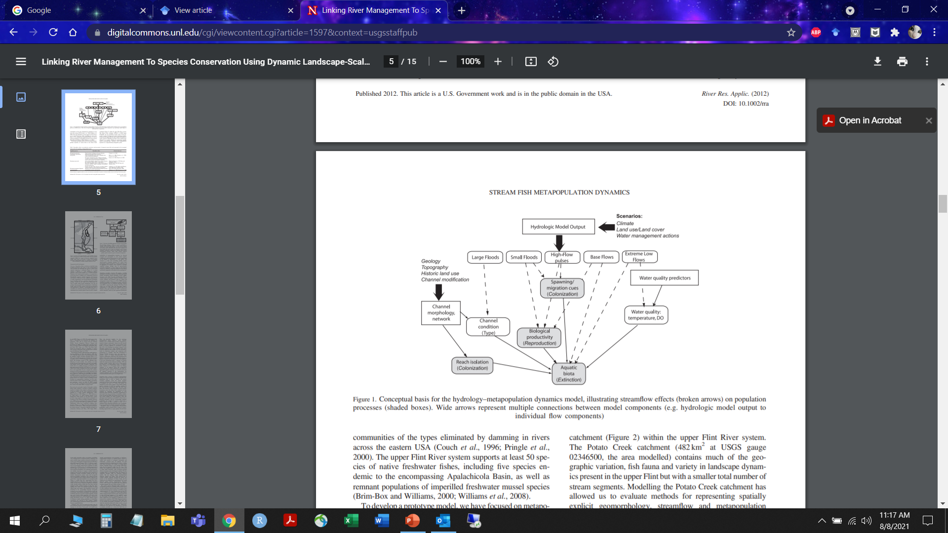
Build a conceptual model
People often skip this step
Freeman et al. 2013

Slide 4
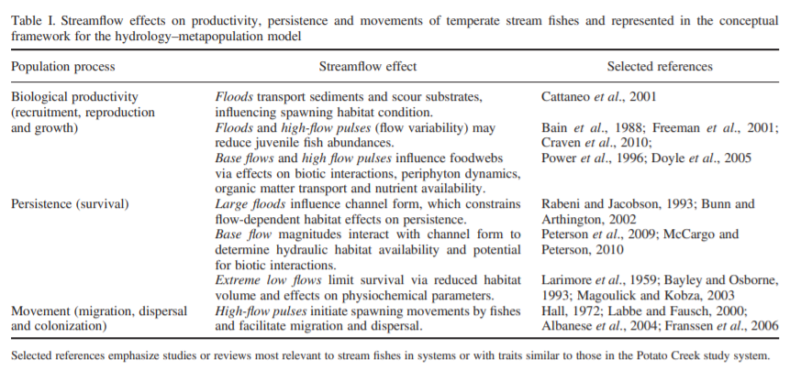
State a priori hypotheses
People often skip this step, too
Freeman et al. 2013

Slide 5
Choose a modeling framework & identify covariates
Here, “model” = some sort of generalized linear model
Lots of potential covariates? Must be strategic.
  Check for correlation/collinearity.
  Are there potential interactions? How realistic do you want to get? How much complexity can your data support?
  Are there a priori hypotheses for each covariate effect?

Slide 6
Identify a candidate set of models
Few covariates (e.g., ≤5)? Possible to fit “all subsets” without too much judgment.
More complicated with LOTS of potential combinations and/or multiple parameters (e.g., survival and recapture probabilities).
Resist automated methods like stepwise-AIC or “dredge”
Example strategies following Morin et al. 2020:
    Sequential-by-submodel
    Secondary candidate set
    Build-up approach

Slide 7
A note about AICc
AICc = -2×ln(likelihood|data) + 2×K + (2×K×(K+1))/(n-K-1)
As n gets big:
(2×K×(K+1))/(n-K-1) = number/very large number
AIC = AICc for large datasets; usually best to use AICc

Slide 8
How is AIC used?
  AIC by itself is meaningless (or at least not very useful).
  We find the best model by comparing various models and examining their relative distance to the “truth”
  We do this by calculating the difference between the best fitting model (lowest AIC) and the other models (ΔAIC).

Slide 9
Construction of candidate model sets
Sequential-by-submodel
Focus on one submodel at a time, carry “best” structure from one submodel to the next
Secondary candidate set
Focus on one submodel at a time, combine “best” structures for final model
Build-up approach
Similar to above but done separately for “types” of covariates e.g., temporal and spatial
For what it’s worth, the simulation study in Morin et al. 2020 identified these as the better approaches

Slide 10
Identify a confidence set of models
If you have only a single model, this obviously isn’t an issue
If >1 model, then you need to decide on some criterion and rule-set for identifying models with support. Some examples…
  ΔAIC_{c} ≥ some threshold e.g., 2 or 4
  Individual AIC_{c} weights ≥ some threshold e.g., 10% of top-ranked model’s weight
  Cumulative AIC_{c} weights ≤ some threshold e.g., 0.95

Slide 11
What about random effects?
Sometimes people use AIC(c) (and ML) to compare random effects structures, then switch to REML to fit the final model
I typically don’t have very complicated random effects models, so this is usually not something I worry about too much.
If there’s a case for observations being clustered/non-independent, then I just include the random effect in all models

Slide 12
Model-based Inference
Models are fit and a confidence set identified. Now what?
Decide up front what’s considered an important effect.
    e.g., 95% CI overlaps zero = not important
    Results and Discussion focus on “important” effects
  Ideally, relate findings back to a priori hypotheses. Are estimates:
    In agreement with your expectations? Good!
    Counter to your expectations? That’s OK, too! But avoid pretending that was your expectation all along!

Slide 13
Prediction and interpreting results
Single model has all the support? Usually simplest to focus on individual covariate effects.
Multiple models have support? Inference is a little trickier…
  Based solely on “best-approximating” model (☹ or ☺).
  Top model in which a parameter appears (☹ or ☺)
  Model-averaged coefficients (☹)
  Model-averaged predictions (☺)

Slide 14
Useful R packages
MuMIn (Barton 2020)
Default AIC table is a little cumbersome, but you can clean it up
‘dredge’ function allows for automation of model-fitting based on a variety of rule-sets
Model-averaging can be done (but haven’t used it for this)
AICcmodavg (Mazerolle 2020)
I like the default AIC tables
No equivalent ‘dredge’ function (package author seems opposed)
Simple functions for calculating model-averaged predictions and coefficients based on a confidence set of models

Slide 15
Useful References
Anderson SC, PR Elsen, BB Hughes, RK Tonietto5, MC Bletz, DA Gill, MA Holgerson, SE Kuebbing , CM MacKenzie, MH Meek, and D Veríssimo. 2021. Trends in ecology and conservation over eight decades. Frontiers in Ecology and the Environment doi:10.1002/fee.2320
Burnham KP, and DR Anderson. 2002. Model selection and multimodel inference: a practical information-theoretic approach. Springer, New York.
Johnson JB, and KS Omland. 2004. Model selection in ecology and evolution. Trends in Ecology and Evolution 19:101-108.
Mac Nally, R, RP Duncan, JR Thomson, and JDL Yen. 2018. Model selection using information criteria, but is the “best” model any good? Journal of Applied Ecology 55:1441-1444.
Morin DJ, CB Yackulic, JE Diffendorfer, DB Lesmeister, CK Nielsen, J Reid, and EM Schauber. 2020. Is your ad hoc model selection strategy affecting your multimodel inference? Ecosphere 11:1-16.

Slide 16
Multimodel inference was never intended to divine some unidentifiable hidden truth in the data, but to make inference about a priori hypotheses conditional on the proposed candidate set (Burnham and Anderson 2002).
- Morin et al. 2020

